Slide 1
Jobfield Recruitment
M Hudya Ramadhana
Mutia Ayu Dianita

Slide 2

<Background/>

Slide 3
<SYSTEM ANALYST/>

Slide 4
<XML AND XSD FILES>
berita.xml
schema
berita.xsd
pegawai.xml
schema
pegawai.xsd
pesan.xml
schema
pesan.xsd
</XML AND XSD FILES>

Slide 5
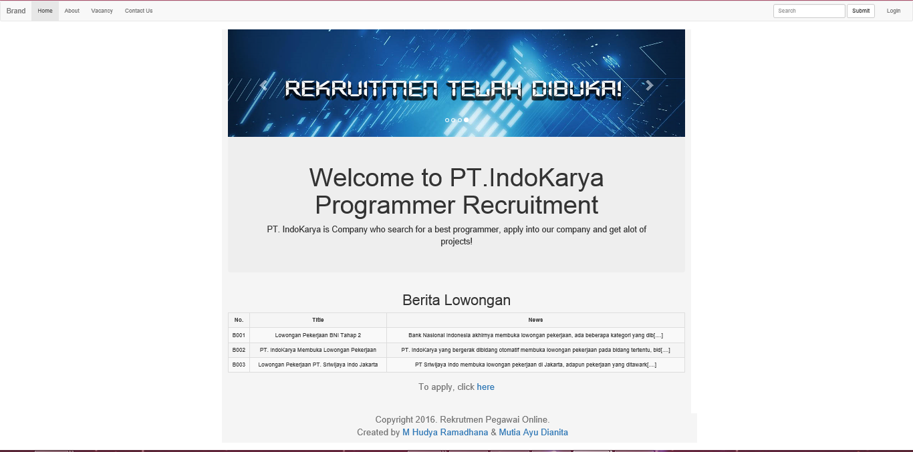
<INTERFACE>

Slide 6
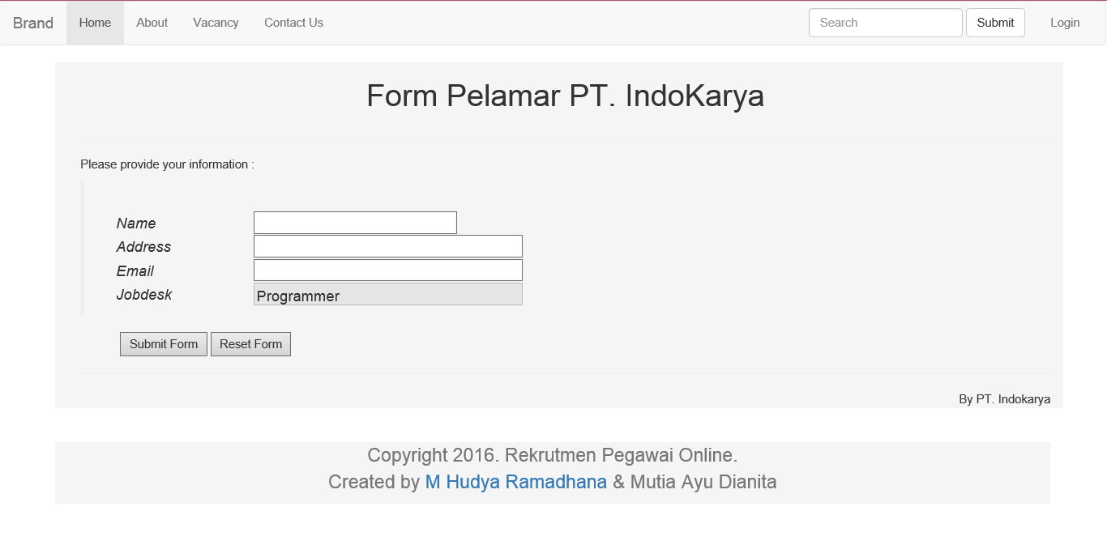
Apply Form

Slide 7
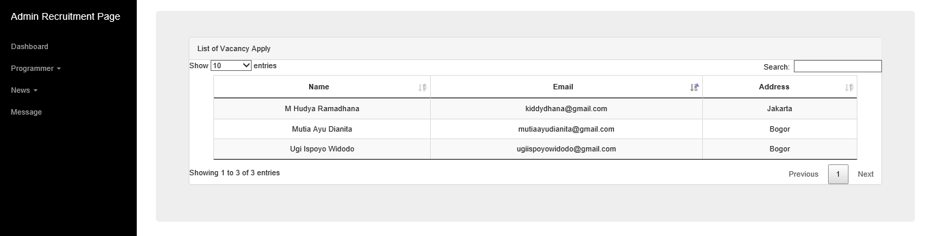
Applier List

Slide 8
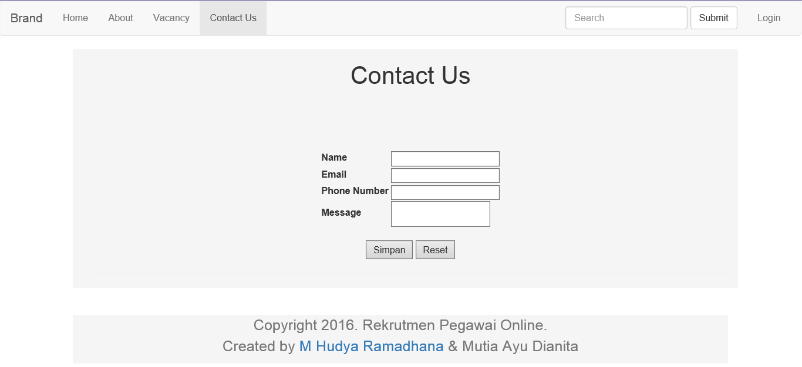
Message form

Slide 9
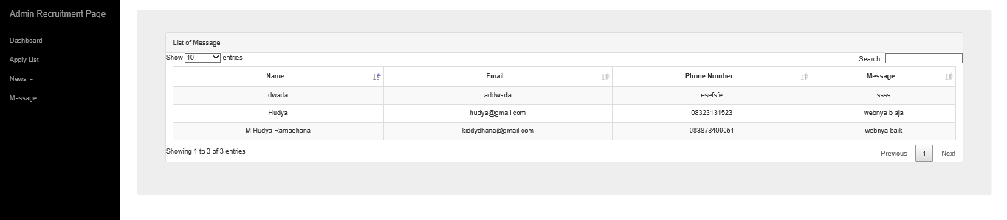
Message List

Slide 10
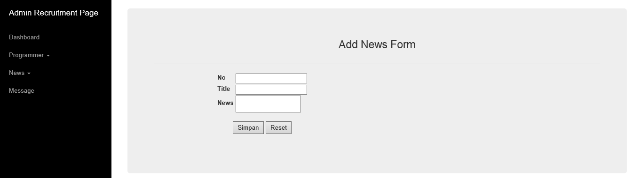
News Form

Slide 11
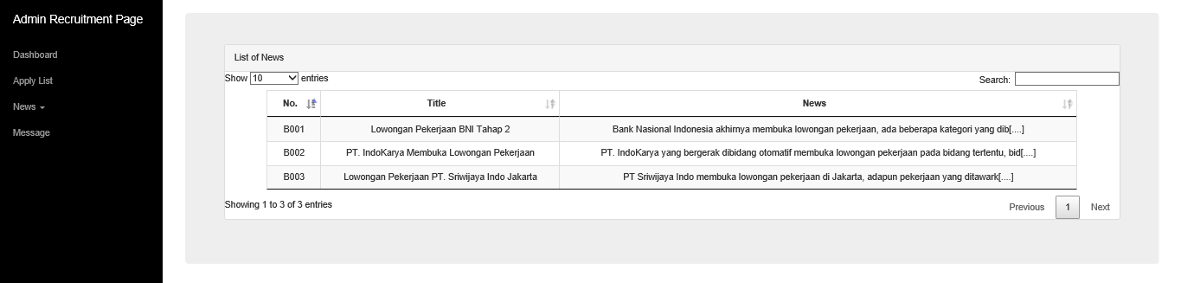
News List
</INTERFACE>

Slide 12

THANK YOU FOR YOUR ATTENTION

